Slide 1







PROFESSIONAL DEVELOPMENT:
GOAL SETTING

Slide 2
INTRODUCTION
What is Professional Development?
Professional development is improving yourself through learning and training to advance your career. There are many ways that employees can work on their professional development, such as taking classes, going to workshops or teaching themselves new skills. Professional development can also refer to staying up to date on new trends within your field and applying new practices to your current methods.

Slide 3

GOAL SETTING
Goal setting is the strategic process of identifying specific, measurable objectives and creating actionable plans to achieve them within a defined timeframe. It provides direction, purpose, and motivation to individuals and organizations. Whether for personal development, career advancement, or business growth, goals help to clarify what matters most, ensuring focused and efficient progress toward desired outcomes.

Slide 4
IMPORTANCE OF GOAL SETTING
Goal setting is fundamental for several reasons, as it provides both individuals and organizations with a strategic framework to drive growth and success. Establishing clear goals fosters a sense of direction, enabling decision-making and resource allocation to align with specific targets. It also cultivates motivation by giving people a tangible outcome to strive toward, sustaining their focus and determination.

Slide 5
TYPES OF PROFESSIONAL GOALS:
SHORT-TERM GOAL
LONG-TERM GOAL
A goal you aim to achieve soon (days, weeks, or months). It is specific, immediate, and helps you make progress (e.g., improving grades this semester).
A goal that takes a longer time to accomplish (years or more). It is broader, future-oriented, and often built from short-term goals (e.g., building a successful career).

Slide 6
SMART GOAL FRAMEWORK
SPECIFICITY
Specificity is crucial, as clearly defined goals eliminate ambiguity and help break down larger objectives into manageable tasks.
MEASURABILITY
is another important factor, as measurable criteria make it possible to monitor progress and assess success. Tracking metrics such as revenue growth, lead conversion rates, or customer satisfaction scores ensures that progress is visible and adjustments can be made as needed.

Slide 7
ACHIEVBILITY
is vital to maintaining commitment and motivation. Setting realistic goals that stretch an individual’s or organization’s abilities without overwhelming them keeps teams engaged and driven.
RELEVANCE
ensures that goals align with broader personal or organizational objectives. This connection maintains focus and reinforces the importance of achieving each goal.
TIMELINESS
establishes deadlines that create a sense of urgency and a clear timeline for completion. With a definitive end date, teams are motivated to act promptly and deliver results efficiently.

Slide 8
GOAL SETTING PROCESS:
IDENTIFY THE OBJECTIVES
Start by defining a clear and meaningful goal that aligns with your personal or organizational priorities.
BREAK IT DOWN
Divide the larger goal into manageable tasks or milestones. This segmentation allows you to handle what might seem like an overwhelming objective in smaller, achievable steps.

Slide 9
DEVELOP A PLAN
Create an action plan that details the steps, resources, and support required to reach each milestone.
SET DEADLINES
Assign timelines to each task and milestone to promote urgency and prioritize activities.
TRACK PROGRESS
Regularly monitor performance against each milestone. Tracking helps identify what’s working well and what might need adjustments.
REVIEW AND REFLECT
Once the goal has been achieved (or a milestone reached), take time to review the outcomes.

Slide 10
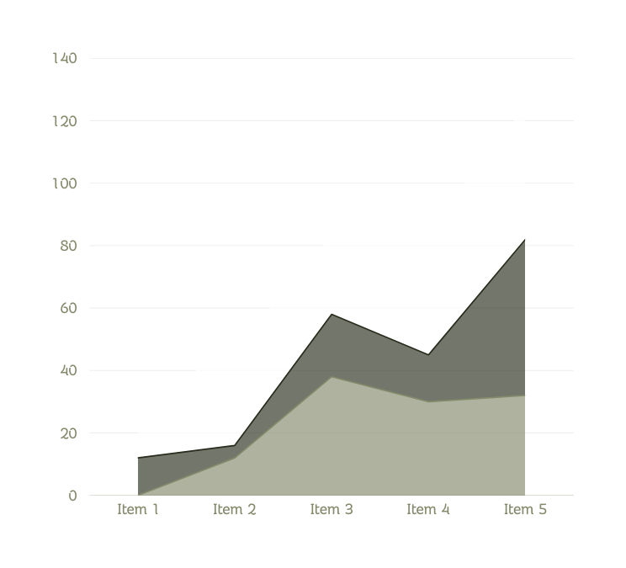
CHALLENGES:
Common obstacles that prevent people from reaching their goals in life include procrastination, fear of failing, lack of time, resources, motivation, and even changing habits. These difficulties frequently result in either delayed success or inability to achieve success in life. But it can also be resolved in a variety of ways such as time-management, accountability partners, resilience, and responsibility.

Slide 11
EXAMPLE OF PROFESSIONAL DEVELOPMENT GOAL:
“Within six months, I will complete a certification in Project Management and apply learned skills to improve workflow efficiency in my team.”

Slide 12
CONCLUSION
Goal setting is a vital tool for professional development as it provides direction, motivation, and a clear measure of progress. By establishing short-term and long-term goals, individuals are able to focus on continuous growth, enhance their skills, and align their efforts with their career aspirations. Effective goal setting not only fosters accountability and discipline but also builds confidence as each milestone is achieved. Ultimately, it serves as a roadmap for success, ensuring that professional development remains purposeful, strategic, and sustainable.

Slide 13
ACTIVITY TIME!!

Slide 14
QUICK ACITIVITY:
With the course you are currently taking, create one short-term goal and one long-term goal that align with the career path you aim to pursue. Be specific and realistic with your goals, and explain briefly how each will help you prepare for your desired profession. You have 10 minutes to finish your activity. Good luck!

Slide 15
THANK YOU

